Slide 1
Module-11: Part-2: BST – Node, Traversal
CS 1714 – Computer Programming II

Slide 2
Binary Search Tree Node Structure
Node structure consists of 3 things – value (mostly int), link to left child and right child.
BST is referred by the ‘root’ node similar to the ‘head’ in a linked list.
typedef struct BSTNode
{
int val;
struct BSTNode* left;
struct BSTNode* right;
} BSTNode;
BSTNode* root;

Slide 3
BST Create New Node
BSTNode* createNode(int v)
{
BSTNode* n = (BSTNode*)malloc(sizeof(BSTNode));
n->val = v;
n->left = NULL;
n->right = NULL;
return n;
}
// Main function
BSTNode* root;
BSTNode* n1 = createNode(1);
BSTNode* n2 = createNode(2);

Slide 4
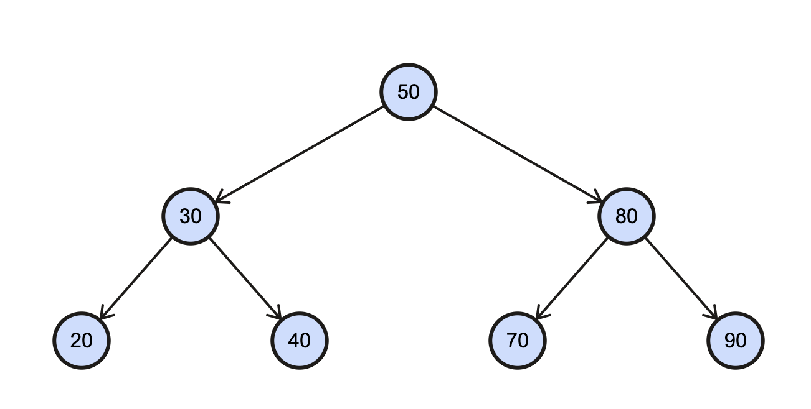
Binary Search Tree Traversal
To traverse a tree, we start at the root node. For each node, we traverse the left subtree and then right subtree.
When we get to a leaf node, we stop and go back to the root.
Start

Slide 5
Binary Search Tree Traversal
void traverse(BSTNode* root)
{
/* base case – moved beyond a leaf */
if(root == NULL)
return;
traverse(root->left); /* traverse left */
traverse(root->right); /* traverse right */
}

Slide 6
BST Traversal
void traverse(BSTNode* root)
{
/* base case – moved beyond a leaf */
if(root == NULL)
return;
traverse(root->left); /* traverse left */
traverse(root->right); /* traverse right */
}

Slide 7
Binary Search Tree Traversal Order
When traversing a BST, there are three orders in which the values can appear:
Inorder: left subtree, root, right subtree
Preorder: root, left subtree, right subtree
Postorder: left subtree, right subtree, root
When we refer to the root in this traversal order, we mean the root of the current subtree (i.e., current node) in which we are accessing/print its data.
zyBooks only covers inorder
NEED to know all 3 traversals

Slide 8
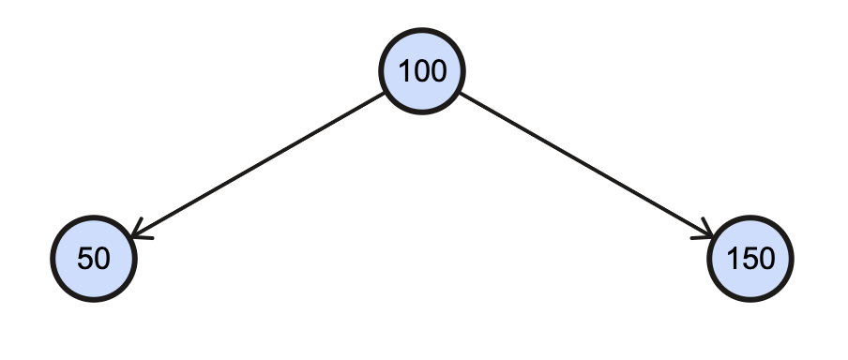
Inorder Traversal
Inorder Traversal Rule (when to access/print): Left subtree, Root, Right subtree
Inorder sequence: 50, 100, 150
Start
Follow the standard tree traversal path (search left, then right)
For inorder:
Search left subtree (if it exists) then print left node’s value
Print root node’s value
Search right subtree (if it exists) then print right node’s value
2
1
3
It will print out the values in ascending order.

Slide 9
Preorder Traversal
Preorder Traversal Rule (when to access/print): Root, Left subtree, Right subtree
Preorder sequence: 100, 50, 150
Start
Follow the standard tree traversal path (search left, then right)
For preorder:
Print root node’s value
Search left subtree (if it exists) then print left node’s value
Search right subtree (if it exists) then print right node’s value
1
2
3

Slide 10
Postorder Traversal
Postorder Traversal Rule (when to access/print): Left subtree, Right subtree, Root
Postorder sequence: 50, 150, 100
Start
Follow the standard tree traversal path (search left, then right)
For postorder:
Search left subtree (if it exists) then print left node’s value
Search right subtree (if it exists) then print right node’s value
Print root node’s value
3
1
2

Slide 11
BST Traversal - InOrder
void traverse(BSTNode* root)
{
if(root == NULL)
return;
traverse(root->left);
traverse(root->right);
}
void printInOrder(BSTNode* root)
{
if(root == NULL)
return;
printInOrder(root->left);
printf(“%d ”, root->val);
printInOrder(root->right);
}

Slide 12
BST Traversal - PreOrder
void traverse(BSTNode* root)
{
if(root == NULL)
return;
traverse(root->left);
traverse(root->right);
}
void printPreOrder(BSTNode* root)
{
if(root == NULL)
return;
printf(“%d ”, root->val);
printPreOrder(root->left);
printPreOrder(root->right);
}

Slide 13
BST Traversal - PostOrder
void traverse(BSTNode* root)
{
if(root == NULL)
return;
traverse(root->left);
traverse(root->right);
}
void printPostOrder(BSTNode* root)
{
if(root == NULL)
return;
printPostOrder(root->left);
printPostOrder(root->right);
printf(“%d ”, root->val);
}

